Slide 1
Interracial Child abuse and neglect for 10-15 year old children
Kourtney Villegas
Domestic Violence 4320
Lamar University Spring 2020

Slide 2
TABLE OF Contents
Introduction
Definition
Types of Abuse and Neglect
Physical Abuse
Sexual Abuse
Psychological Abuse
Neglect
Causes of neglect
Consequences of child abuse and neglect
Race and ethnicity
Statistics
Serious incident of child neglect
Effectiveness of intervention programs
Child abuse and neglect prevention organizations
Evidence of neglect
Works Cited

Slide 3

INTRODUCTION
The seriousness behind child abuse and neglect.
Notes:
Throughout this power point we will take an in depth look into the seriousness behind child abuse and neglect. What is the definition of neglect? What causes neglect? What are the consequences of neglect? What type of impact does child neglect have on others in the family? Where must a child experiencing child neglect receive assistance? These are a few of the questions that will be answered throughout the PowerPoint. The specific target for this research project is to dig deeper into interracial children, ages 10-15 years old. This specific group is effected at a high rate because of low self esteem, past abusive relationships, stress, financial problems, and past family violence. The reason I chose this topic is because I am of mixed races and wanted to see the characteristics involved with child abuse and neglect and the reasoning behind it for children at a young age. The statistics involved with this concept as well come at an alarming rate.

Slide 4
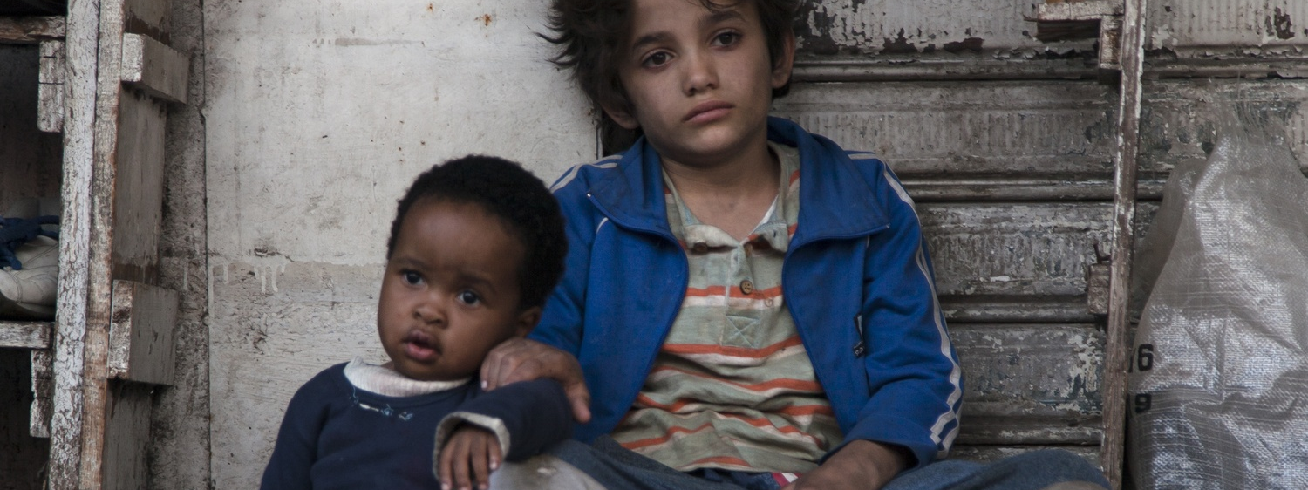
Definition
What is child abuse and neglect?
Photo Cred: https://www.thecrimson.com/article/2018/5/19/capharnaum-review/
Notes:
What is child abuse and neglect? According to the textbook, “any act committed against a child by a caretaker that causes death, harm, or risk of harm—physical, sexual, or psychological—may be considered child abuse and neglect. The failure to provide care and protection may also be considered abuse or neglect.” (2013) There are many reasons why parents or guardians may expose their children to neglect. Neglect is not as obvious as child abuse. Child abuse may leave scars, bruises and can be seen by the naked eye. Neglect is a more chronic issue that develops over time.

Slide 5
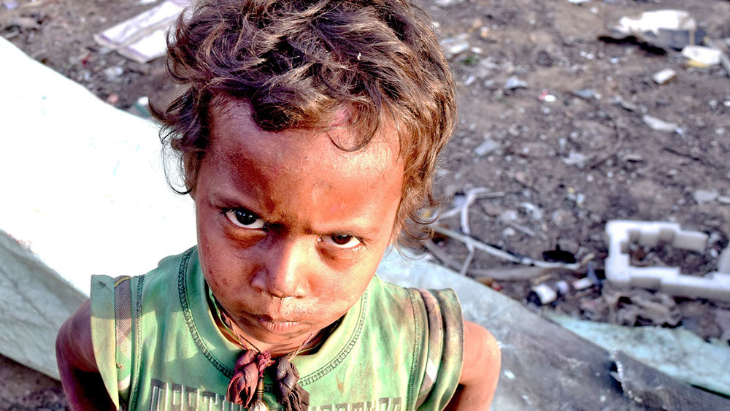
Types of Abuse and neglect
Physical Abuse
Sexual Abuse
Psychological Abuse
Emotional Abuse
Neglect
Photo Cred: https://stopabusecampaign.org/faq-the-ace-study/what-are-adverse-childhood-experiences-aces/what-is-physical-neglect/
Notes:
There are many types of abuse and neglect that children may experience. Physical, sexual, psychological and emotional abuse are to name a few. Physical abuse is described as any action that results in a physical impairment or death of the child such as striking, kicking, burning, or shaking (2013). Sexual abuse refers to sexual acts or sexually motivated behaviors involving children such as: fondling a child’s private areas, indecent exposure, genital penetration, or genital contact with no intrusion (2013). Psychological abuse is the intentional infliction of anguish, pain, or distress designed to control the victim. The verbal or nonverbal forms of psychological abuse include the infliction of emotional abuse (2013). Emotional neglect may include the following: exposure to chronic intimate partner violence, permitted drug or alcohol abuse and delay in psychological care (2013). As a parent or guardian, the main objective is to provide for your children. As a caretaker children should have adequate amount of food and water to survive. Their living conditions should be suitable as well. Failure to provide this opportunity for children results in neglect.

Slide 6
PHYSICAL ABUSE
EXAMPLES OF PHYSICAL ABUSE (2013):
-Hitting
-Striking
-Burning
-Kicking
-Locking a child in a closet
-Shaking
Notes:
This slide gives you a little information regarding physical abuse. Hitting, striking, burning, kicking, slapping, and shaking are a few examples of physical abuse that a child/children may experience. If not treated correctly the lasting effects with physical abuse may cause harm or even death. Physical abuse is the most appealing aspect of child abuse. Physical abuse is easy to detect because of the physical attributes of scarring and bruises.

Slide 7
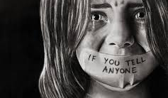
Sexual abuse
Examples of Sexual Abuse (2013):
-Using a child in pornography.
-Fondling a child's genitals.
-Sexual intercourse with a child.
Photo Cred: https://www.pakistantoday.com.pk/2018/01/27/222-child-sexual-abuse-cases-reported-in-kp-since-may-2011/
Notes:
The most revealed type of abuse is sexual abuse and neglect. Not many adolescents will speak out against sexual abuse in fear of the perpetrator receiving criminal punishment. Most sexual abusers threaten the children so they do not speak out. They strike fear in the child and want them to remain silent.

Slide 8
Psychological abuse
Examples of Psychological Abuse:
-Stress
-Anxiety
-Post Traumatic Stress Disorder
-Low Self Esteem
-Insomnia
Notes:
Psychological abuse involves the effects that happen after child abuse (2013). A child/children will develop such factors like: stress, anxiety, post traumatic stress disorder, low self esteem and insomnia. These factors are considered long term effects of child abuse and neglect.

Slide 9
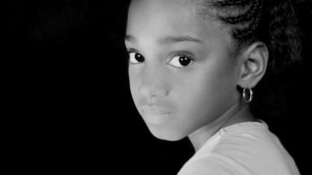
NEGLECT
Types of Neglect:
-Physical neglect
-Medical neglect
-Educational neglect
-Emotional neglect
Photo Cred:https://isreview.org/issue/91/race-and-class-us-foster-care-system
Notes:
Neglect is a pattern of failing to provide for a child’s basic needs (2013). There are four types of neglect: physical, medical, educational and emotional. The effects of neglect are over a period of time. The physical demands for a child refers to where they live, the cleanliness of their household, and are they provided with adequate food and water. The medical needs consist of: clinical meetings, regular dentist visits and pharmaceutical needs. Neglect may also be effected through educational purposes. Is a child attending school? Is the child functioning properly in the classroom environment?

Slide 10
Causes of neglect
Intrapersonal
Family issues
Social/economic factors
Notes:
The causes of neglect are categorized by intrapersonal causes, family issues, or social and economic causes. Poverty, unloving relationships, drug or alcohol abuse, depression, violence within the family, lack of support from the family, inadequate living conditions, mental health issues and past experiences being neglected are a few reasons why a parent or guardian may neglect their child/children. Interracial children are at a high risk because most of their parents have experienced these causes and do not have the adequate resources to get help. Therefore, the chance to neglect their child is on the rise. Poverty is sought out to be the #1 reason why mixed-race children may experience abuse and neglect. (works cited)

Slide 11
Consequences of child abuse and neglect
Physical Health consequences
Psychological consequences
Behavioral consequences
Societal consequences
Notes:
There are short- and long-term consequences of child abuse and neglect. Short term consequences are more associated with the physical health consequences. If a child suffers a bruise or scar from physical abuse, then they will need immediate medical attention. Normally medications, ice, or wraps can cover up the effects of a physical attack against a child very quickly. The long-term consequences are normally associated with psychological, behavioral and societal consequences. Psychological consequences effect a child over time because they feel like they are not appreciated. A child/children that suffers neglect at a young age will grow up with low self esteem. They are constantly questioning their self worth because of the neglectful situations. Abuse and neglect for children yields behavioral and societal consequences as well. A child that has experienced abuse or neglect may not be able to cope with situations at school. They are behavioral problems because of their current situations. According to research funded by the National Institute of Justice within the U.S. Department of Justice, Office of Justice Programs, children who experience maltreatment in the form of physical and emotional abuse are more likely to develop antisocial behaviors and form relationships with other antisocial people (childwelfare.gov)

Slide 12
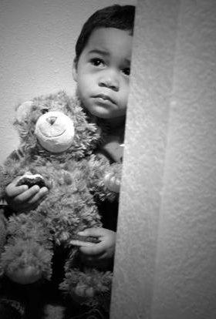
Race and ethnicity
Highest rates of victimization:
-American Indian
-African American
-Interracial
-Pacific Islander
-White
-Hispanic
-Asian
Photo Cred: https://www.military.com/daily-news/2015/09/03/pentagon-stats-rising-rates-us-military-child-abuse-neglect.html

Slide 13
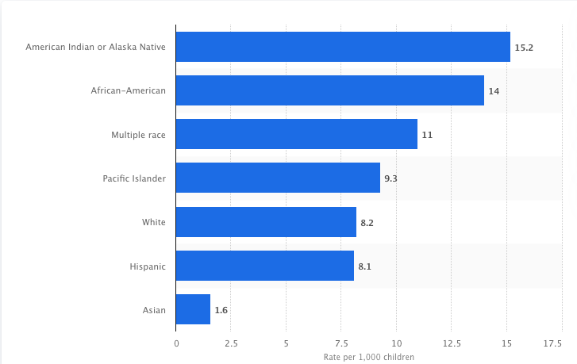
Statistics
Table 1.1 Child abuse rate in the U.S. in 2018, race/ethnicity of the victim.
Photo Cred: https://www.statista.com/statistics/254857/child-abuse-rate-in-the-us-by-race-ethnicity/
Notes:
Let’s look at a table (Table 1.1) that proclaims the child abuse rate in the United States in 2018, by race/ethnicity of the victim. Mixed races ranks 3rd all time. Other minority groups such as African American and American Indian rank above Multiple races. The Asian race ranks as the lowest ethnic group. This table is a great way to understand the breakdown of races related to child abuse. The factors for each socio-economic group will differentiate but the most prevalent factor is considered to be poverty.

Slide 14

Serious incident of child neglect
Notes:
A child experiencing neglect may ask themselves 100 times, when is this enough and when is it time to receive help. After watching this video you may understand the seriousness of neglect and some of the experiences that a child may go through. This incident involves 4 young children who were adopted into foster care. The young men were starved to death by the members of the family. The cry for help came at an opportune time and they were able to receive assistance. Without the help of others they would have starved to death in this household. As someone that is not truly aware of the effects of child neglect, I cant believe that any person would have to go through this.

Slide 15
Effectiveness of intervention programs
National Organizations
Local/Regional Organizations
Notes:
What if a child suffering with child abuse and neglect needs help? Are there support systems to help them cope with this condition? The answer to these questions is, yes. There are national and area organizations that are established to help children reach out and gain support if they are victims of child abuse and neglect. The textbook states, “typical mandated reporters include physicians, child caregivers, police officers, and teachers.” (2013). An interracial student typically involved with the education system interacts with school personnel on a constant basis. This relationship allows them to open up with the school personnel and work on receiving the necessary help.

Slide 16
Child abuse and neglect prevention organizations
-American Professional Society on the Abuse of Children (Columbus, OH)
-American Psychological Association (Washington, DC)
-Bikers Against Child Abuse International (La Crosse, WI)
Notes:
The following is a list of organizations that provide information on resources for preventing child abuse and neglect. There are organizations nationally, regionally, and locally that help provide a haven for children that experience child abuse and neglect.

Slide 17
Evidence of neglect
Notes:
Click on the video of a news reporting a serious incident of child abuse and neglect. The incident involves a family that is being convicted of child abuse or neglect. This story involves 10 children that experienced child neglect. The most serious factor involves the living condition of the family.

Slide 18
Works cited
Gosselin, D.K. (2013). Heavy Hands: an introduction to the crime of intimate and family violence. Upper Saddle River, NJ: Prentice Hall.
https://www.childwelfare.gov/pubpdfs/long_term_consequences.pdf
https://www.childwelfare.gov/state-resources/
https://consumer.healthday.com/encyclopedia/children-s-health-10/child-development-news-124/child-neglect-648566.html

Slide 19

All of the following are examples of physical abuse except:
Striking
Biting
Fondling
Shaking
Notes:
Correct Answer= C. Fondling

Slide 20
Mixed races ranks ___ in victimization of race regarding child abuse.
3rd
1st
Last
5th
Notes:
Correct Answer= A. 3rd.

Slide 21
_______ is considered the #1 reason why mixed race children experience neglect.
Low Self Esteem
Poverty
Family issues
Family violence
Notes:
Correct Answer= B. Poverty.

Slide 22
All of the following are mandated to report child abuse except:
physicians
teachers
police officers
parents
Notes:
Correct Answer= D. Parents.

Slide 23
There are four types of neglect. All of the following are types of neglect except:
social
physical
emotional
educational
Notes:
Correct Answer= A. social

